Slide 1
A VERY brief discussion of data analysis and computational biology
W. Frank Lenoir, PhD

Slide 2
Who I am?
GSBS QS – Bioinformatics student from 2016-2020
Part of various student groups while at GSBS
Interned at MLB
Currently Senior Scientist at Kronos Bio (Cambridge, Mass)

Slide 3
Why I care
Science literacy – important for research
Distrust in computational biology is real
- Often comes from complexity of modeling (completely my opinion)
Science is multidisciplinary, it is good to have a healthy balance

Slide 4
Why you should care
Science is multidisciplinary, it is good to have a healthy balance
Data science is a tool that can be used to answer scientific problems.
- Science Literacy!!

Slide 5
Agenda + Goals
“Rant” Section
Defining terms
Common tools of the trade
Statistics Etiquette
What does properly formatted data look like?
Notes on effective visualizations
Hands-on R workshop
“Coding” Section

Slide 6
Remember
Like any scientist at the wet bench, computational science takes time and practice to learn and understand.
It is not something that can be learned in a day.
Need some help? QS offers the CATS (computational assistance and tutorial session) program. More info here: https://gsbs.uth.edu/quantitative-sciences/

Slide 7

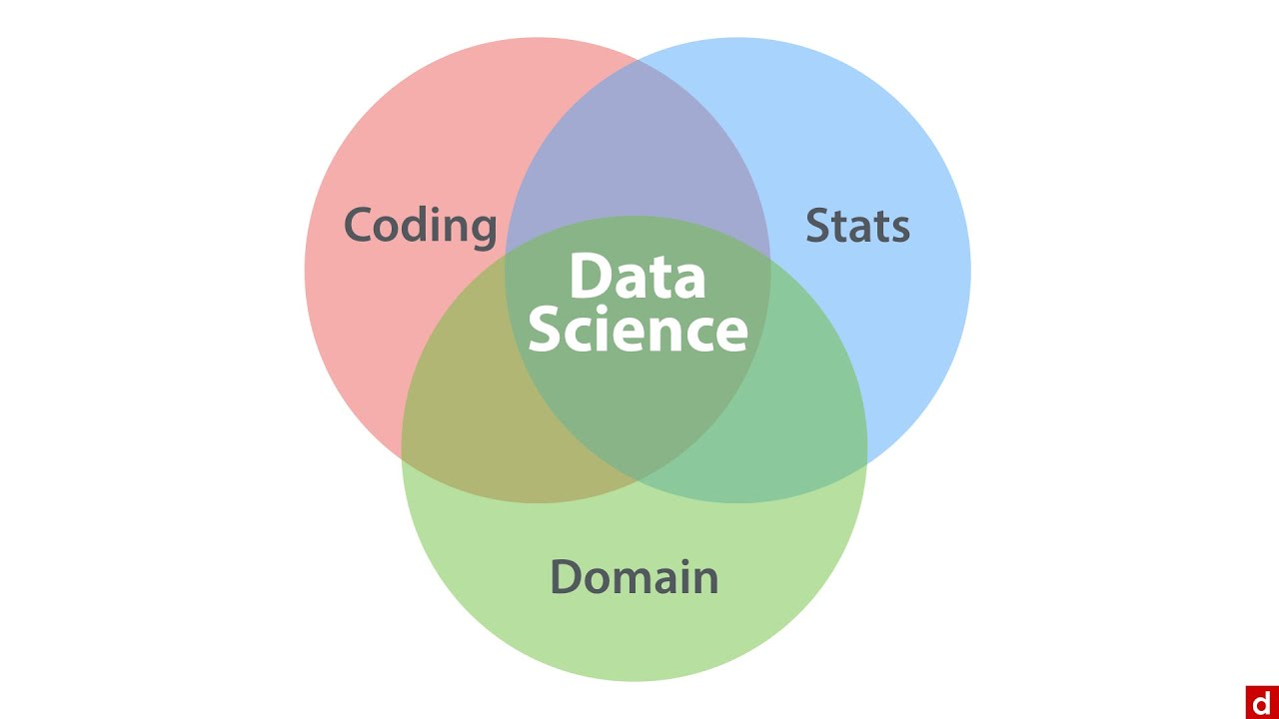

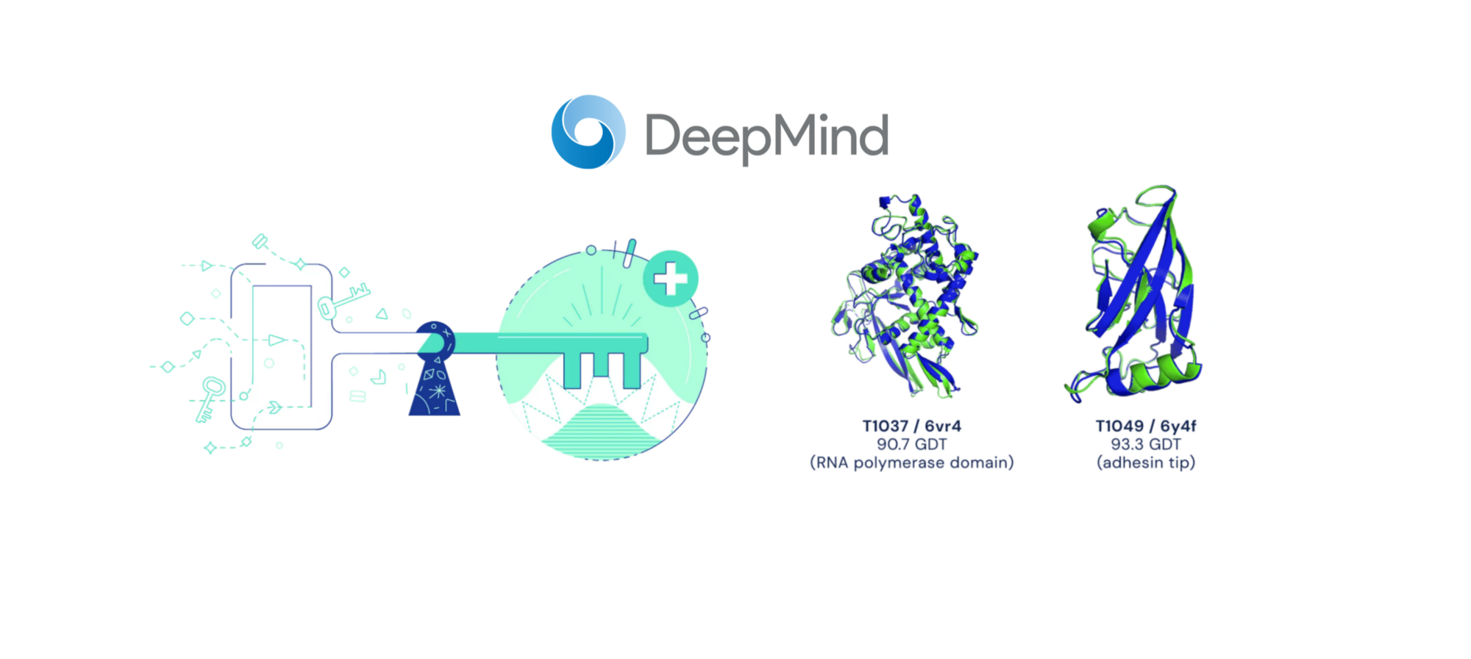
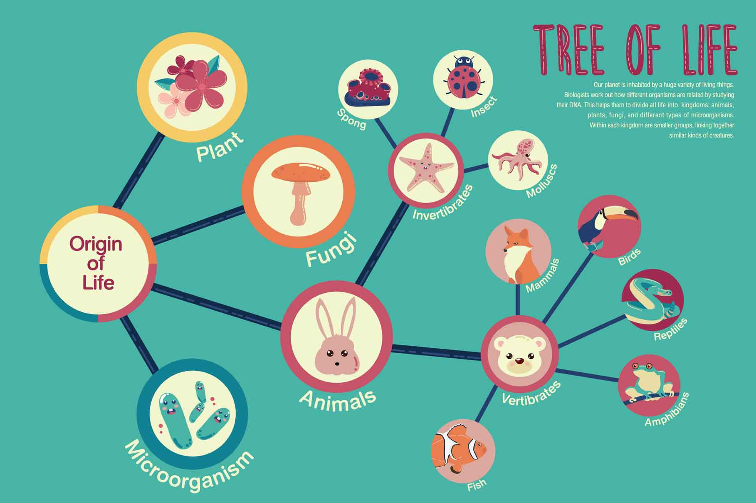
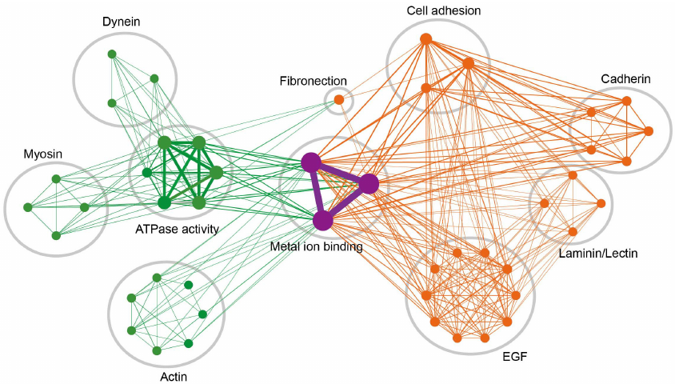
Defining Terms
Data Science
for all fields not specific to biology
Specific to Biology/Medicine
Bioinformatics/Computational Biology
Topics within medicine:
sequence alignment
drug design
drug discovery
protein structure
gene/protein interactions including function associations
evolution
Methods incorporated:
Pattern Identification
Data Mining
Machine Learning
Visualization

Slide 8
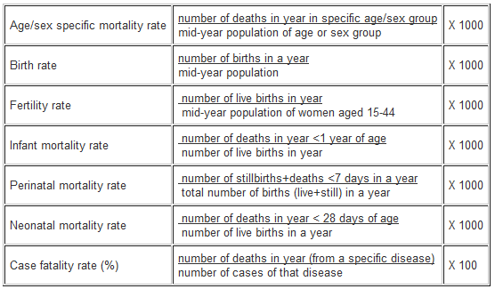
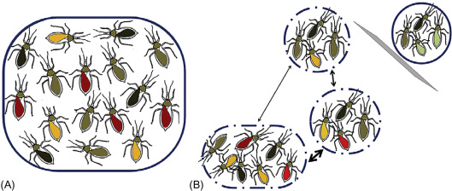
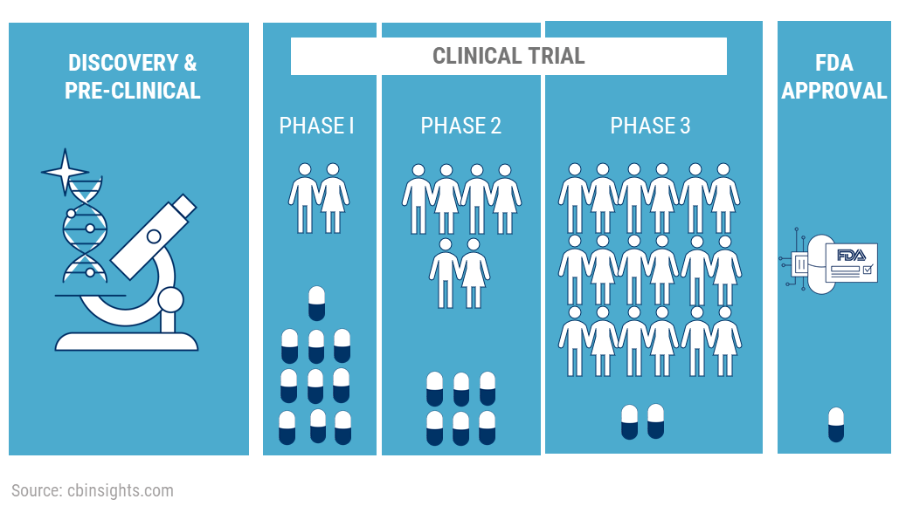
Defining Terms
Data Science
for all fields not specific to biology
Specific to Biology/Medicine
Biostatistics
Topics within medicine:
Epidemiology
Population genetics
Clinical trials
Much more stats heavy, occasionally more theoretical

Slide 9


Tools of the trade #1
Grad School = Being able to think critically of information
Lots of software or coding packages intended for biologists
For help with coding

Slide 10


Tools of the trade #2
Workflow
Source Language: Python, R
Python, R
GUI: Jupyter Notebook,
Rstudio
Category | Excel | Prism | Python,R
Data | Intended to handle small spreadsheets/data | Intended for basic statistical analysis of data | Can handle many different forms of data (no point and click)
Figures | A few visuals are possible | Common science figures | Lots of figure options
Statistical Capabilities | Summary statistics | More common statistical tests available | Everything from basic/common to complex
Write code
Output visuals, or analysis

Slide 11
Tools of the trade #2
Source Language: Python, R
Python, R
Which should you learn?
-Python is a scripting language for complex modeling, or handling larger data sets
-R is generally better suited for visuals
GUI: Jupyter Notebook,
Rstudio
Write code
Output visuals, or analysis

Slide 12


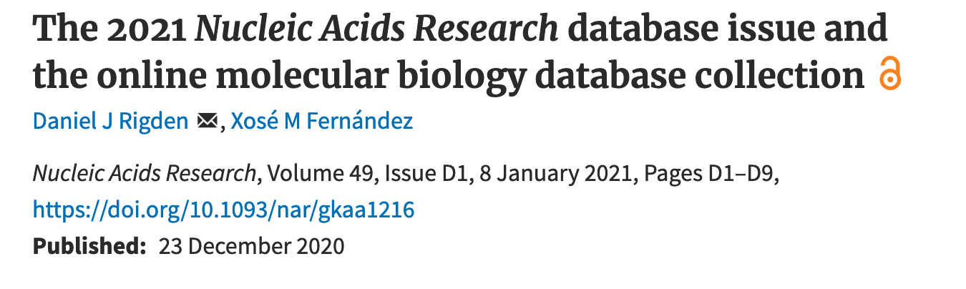

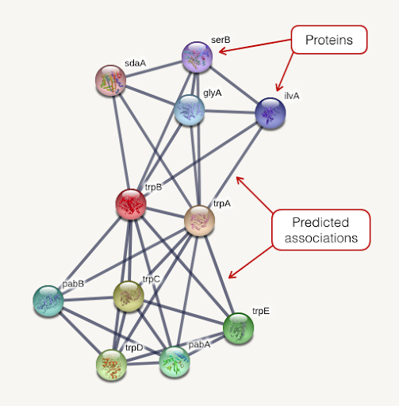


Tools of the trade #3
Online databases research specific
Looking for a database? Check NAR
If you are interested in oncology
Warning: LEARN HOW TO USE A DATABASE
THEY GENERALLY HAVE FAQ
Warning #2: DATABASES OFTEN DIE AFTER SOME TIME

Slide 13
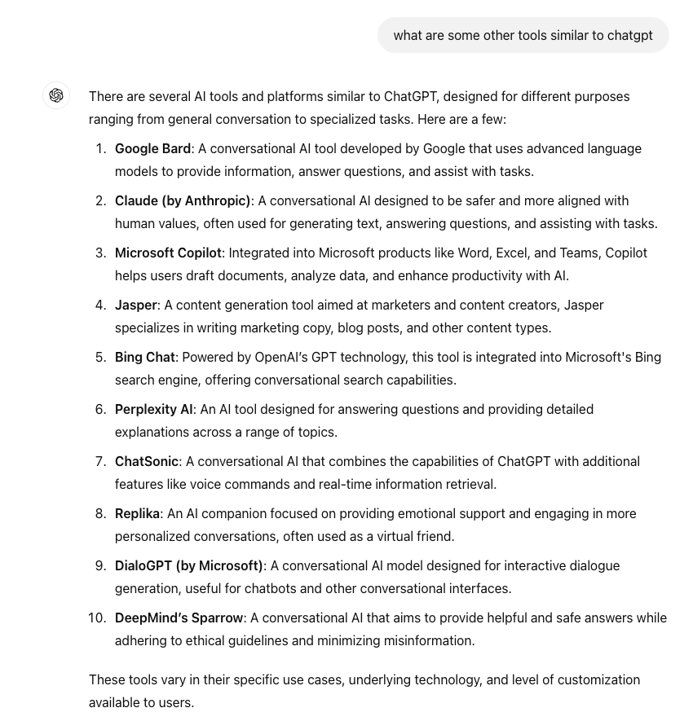
Tools of the trade #4 – AI, frequently wrong
Query pulled from ChatGPT 8/12/24,
Google Bard was rebranded as Gemini in Feb 2024

Slide 14
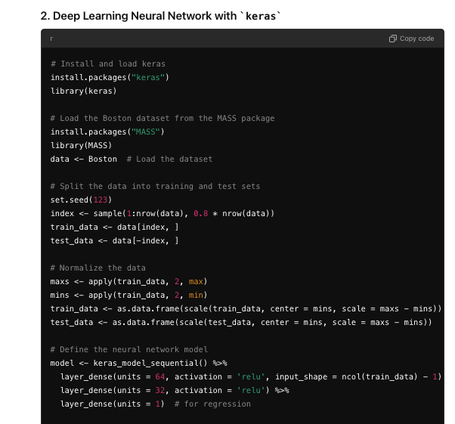
Tools of the trade #4 - AI, frequently useful
- These tools are useful for generating code.
Do not expect these tools to generate perfect code!
Its important to still understand what the code is doing.
- Grad School = Being able to think critically of information

Slide 15
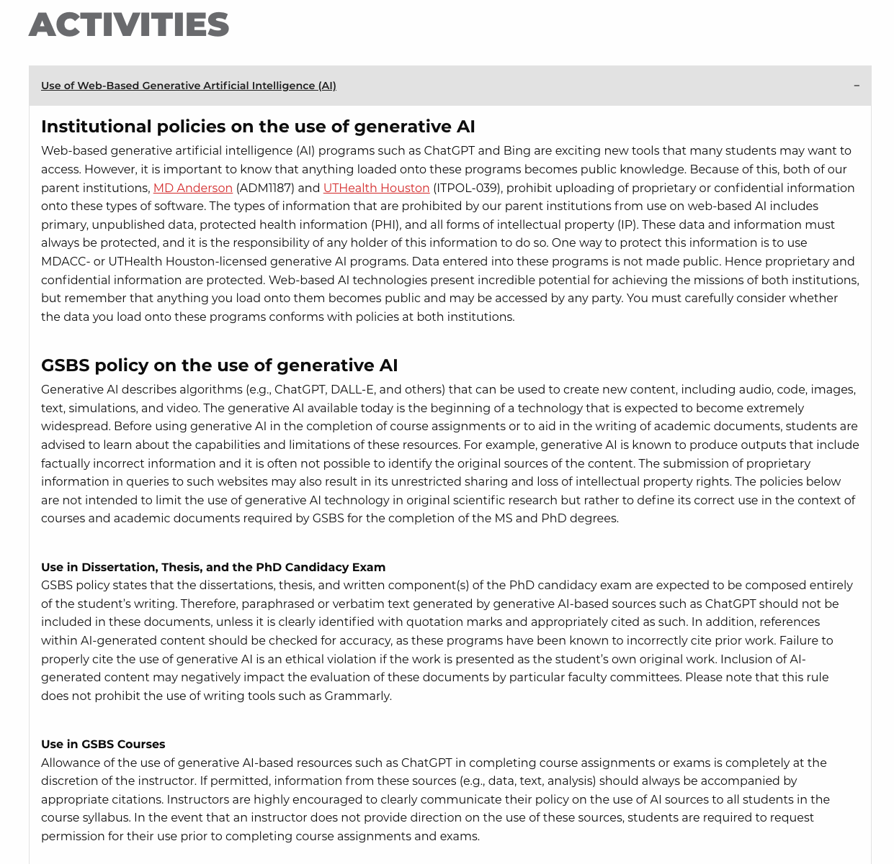
Tools of the trade #4 – AI
https://gsbs.uth.edu/academics/policies-and-procedures
Be careful with what you upload/post, especially when it comes to patient data.
Its okay to use appropriately, just be cautious.
Notes:
Be careful

Slide 16
Brief Statistics Etiquette
Important to mention topic, but please take a class if wanting to learn more.
We use statistics to answer very specific questions. Ask the question first, then incorporate the statistical test second.
What really is a p-value?
Biology always has noise, never take data quality for granted
Keep it simple
Always verify if possible

Slide 17
Break? 3-5 min? Entering ”Coding” Section

Slide 18
Graphic Literacy
Plots can get hectic and complex very quickly but remember the intended purpose of a figure is to convey a story. Ask yourself what is the author trying to tell?
A good plot will only have 2-3, rarely 4, variables at most.
To easily make visuals within R, we need to have tidy data

Slide 19
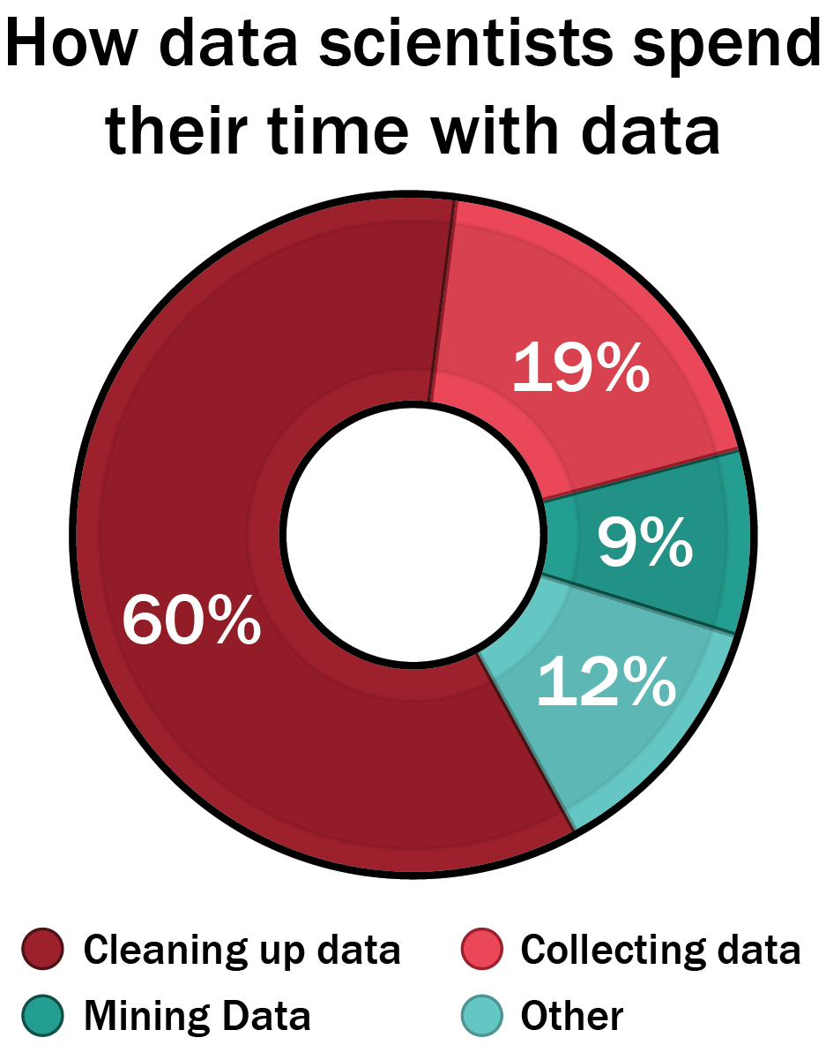
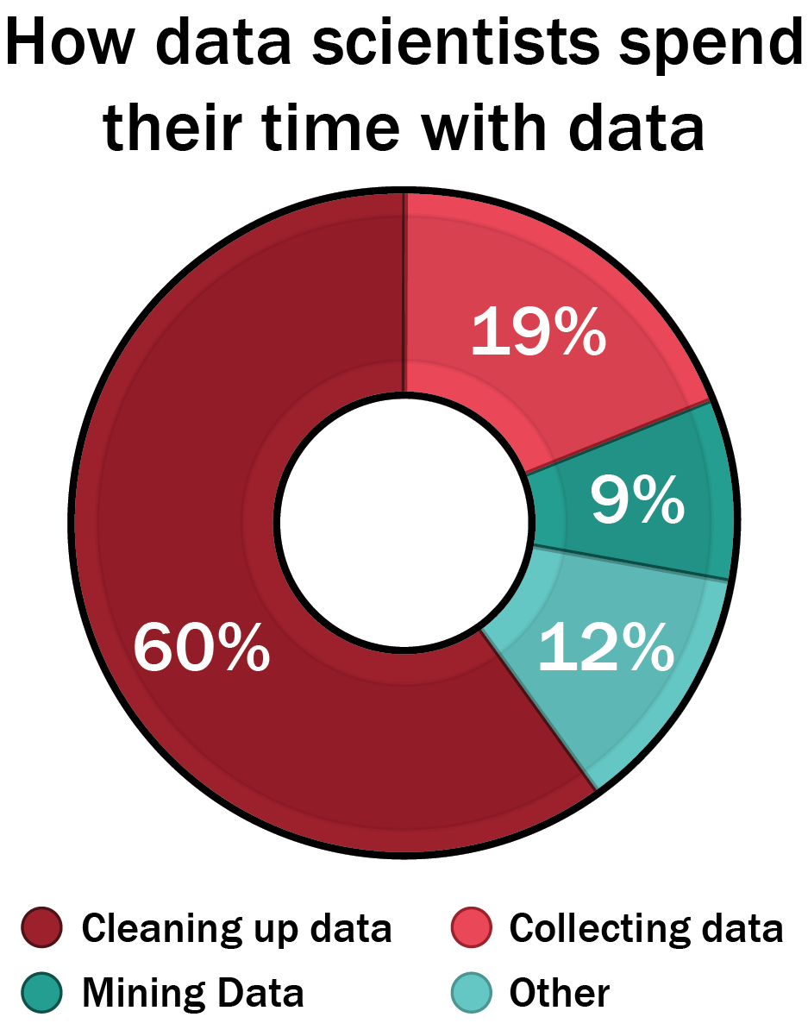
Why tidy data matters?
“Tidy datasets are all alike but every messy dataset is messy in its own way”
- Hadley Wickham
*adapted from forbes.com

Slide 20
What is messy data?
Multiple variables in a single column
Specific to coding generally
Variables expressed in both rows and columns
 | Survived |  | Died
 | Female | Male | Female | Male
Drug | 15 | 14 | 3 | 2
Placebo | 4 | 6 | 10 | 12
Messy Data

Slide 21
What is tidy data?
Single observation type per table
Each column is a variable
Patient ID | Gender | Treatment | Outcome
1 | Male | Drug | Survived
2 | Female | Drug | Survived
3 | Female | Placebo | Survived
4 | Female | Placebo | Died
5 | Male | Drug | Died
. . . | . . . | . . . | . . .
Each row is an observation
Tidy Data

Slide 22
Tools for making tidy data and nice visuals
Dplyr: R package for transforming/reshaping datasets
Command |  |  | Action
filter( ) |  |  | Select rows
select( ) |  |  | Select columns
mutate( ) |  |  | Create new columns
arrange( ) |  |  | Sort rows
summarize( ) |  |  | Calculate summary statistics
group_by( ) |  |  | Group data by a given parameter

Slide 23
What is an effective data visualization?
Always have a purpose, what is the story you are trying to tell?
https://www.youtube.com/watch?v=jbkSRLYSojo
Notes:
https://www.youtube.com/watch?v=jbkSRLYSojo good example of how data viz can be a communicator of science

Slide 24
Less is more…usually

Slide 25
Make sure the figure is worth showing

Slide 26
Avoid Pie Charts and 3D
Which section is largest? Which section is smallest?
Notes:
Pi charts hard to read, generally difficult to communicate, many instances don’t make sense

Slide 27
Avoid Pie Charts and 3D
Notes:
Pi charts hard to read, generally difficult to communicate, many instances don’t make sense

Slide 28
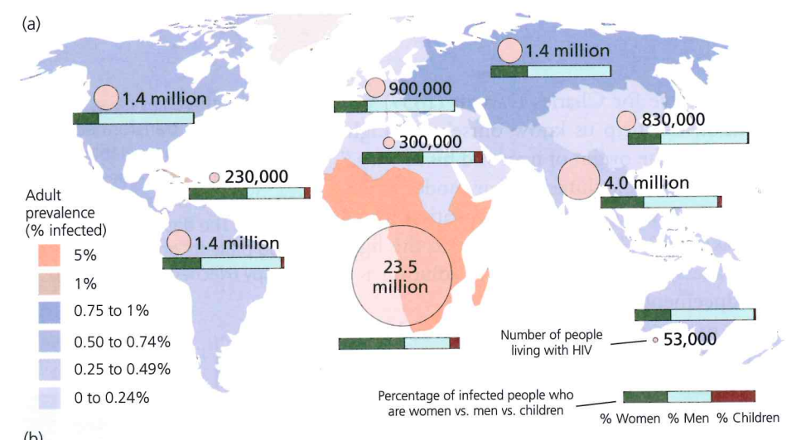
Aim for three variables, no more than four.
Notes:
how many variables is this? I count 4, location, % infected, percentage infected, and # infected.

Slide 29
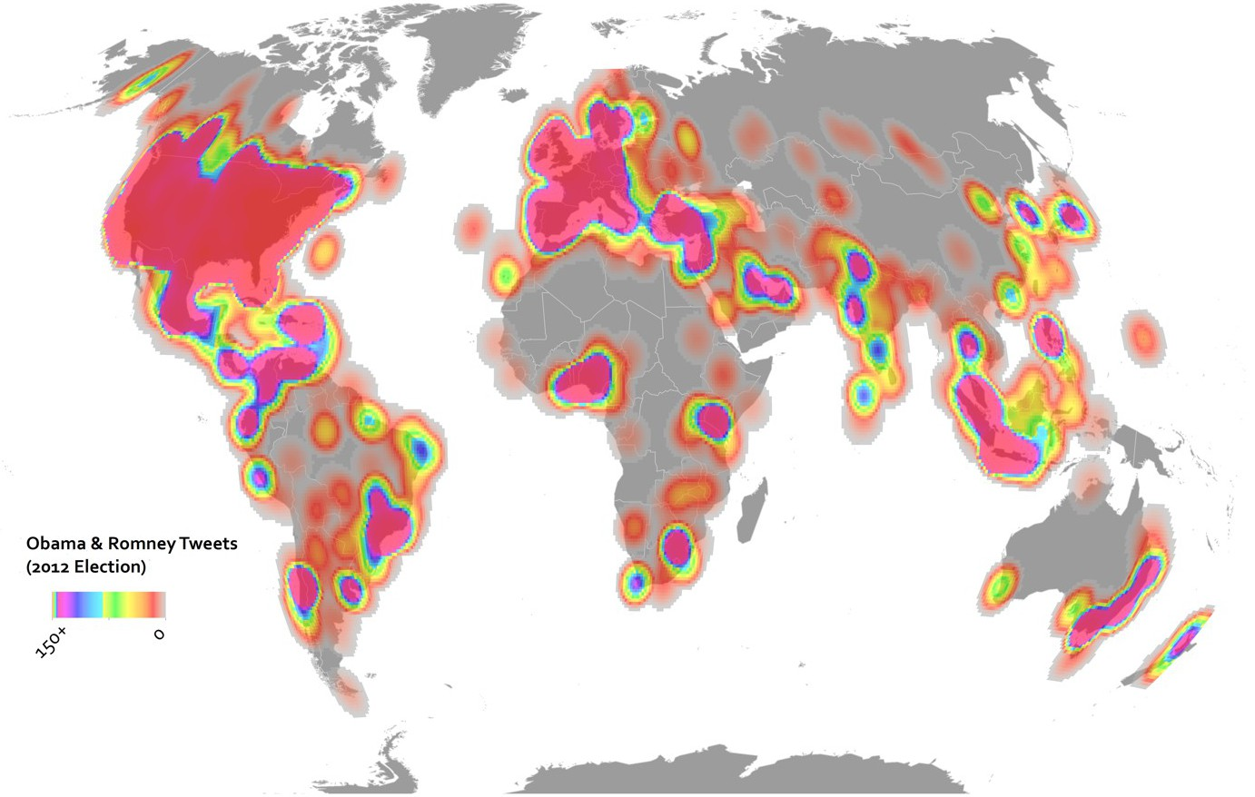
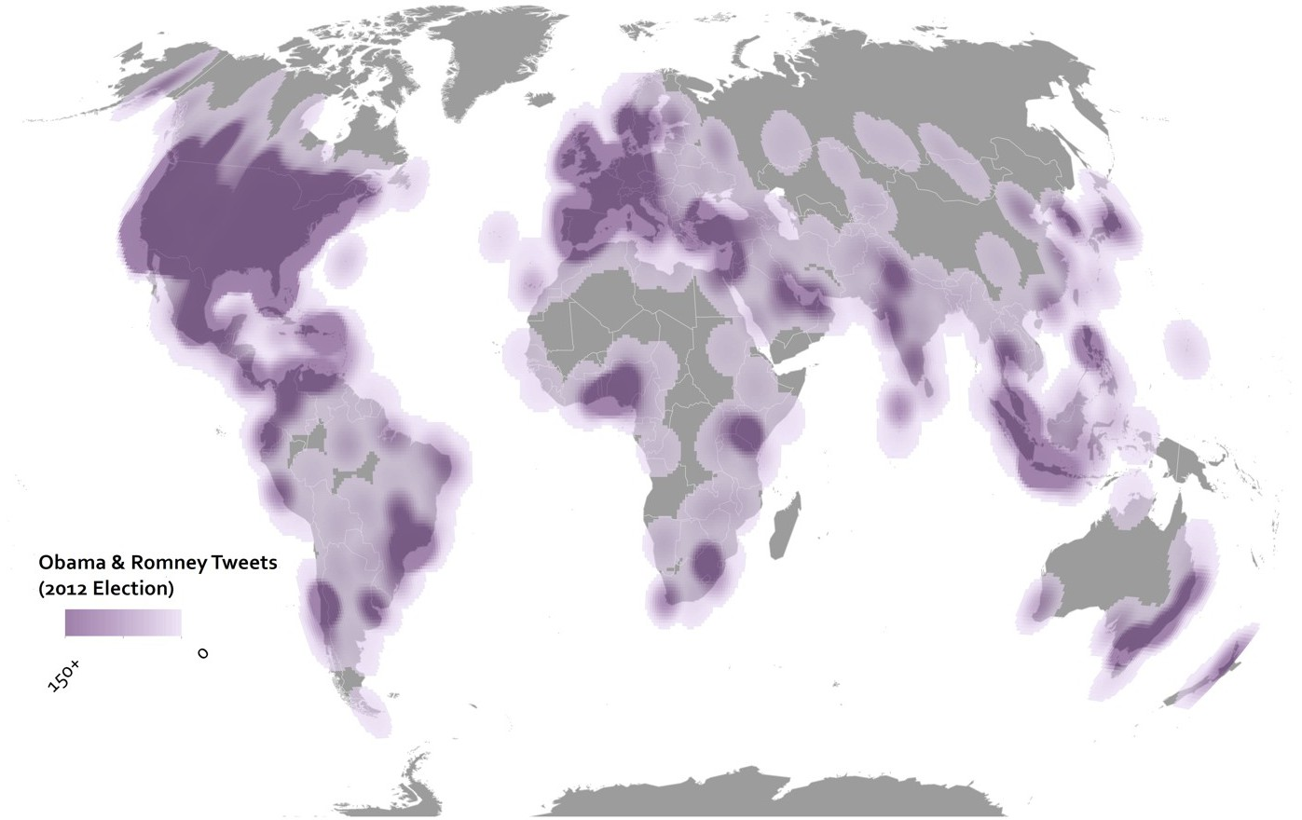
Limit the use of colors
Notes:
Try to limit color use for only variables – never for decoration, aim for clear background

Slide 30
Keep it simple
Notes:
Have things labeled, aim so that anyone could read it, keep it basic.

Slide 31
Slides and Workshop Made By Dr. Claus Wilke

Slide 32
Slides and Workshop Made By Dr. Claus Wilke

Slide 33
Slides and Workshop Made By Dr. Claus Wilke

Slide 34
Slides and Workshop Made By Dr. Claus Wilke

Slide 35
Slides and Workshop Made By Dr. Claus Wilke

Slide 36
Slides and Workshop Made By Dr. Claus Wilke
Notes:
Is this data considered tidy or not?

Slide 37
Slides and Workshop Made By Dr. Claus Wilke

Slide 38
Slides and Workshop Made By Dr. Claus Wilke

Slide 39
Slides and Workshop Made By Dr. Claus Wilke
Notes:
Incorporating all four variables into one plot.

Slide 40
Slides and Workshop Made By Dr. Claus Wilke
Notes:
Still specifying the size in the weight column

Slide 41
Slides and Workshop Made By Dr. Claus Wilke

Slide 42
Slides and Workshop Made By Dr. Claus Wilke
Notes:
Facet based on categorical

Slide 43
Slides and Workshop Made By Dr. Claus Wilke
Notes:
Same ggplot, and just change the geom type, and it changes the plot accordingly. Facet based on numeric

Slide 44
Slides and Workshop Made By Dr. Claus Wilke

Slide 45
For Future Lectures or Notes
https://wilkelab.org/classes/SDS348_spring_2015.html
https://r4ds.had.co.nz/index.html
Slides and Workshop Made By Dr. Claus Wilke

Slide 46
Hands on R Workshop!

Slide 47
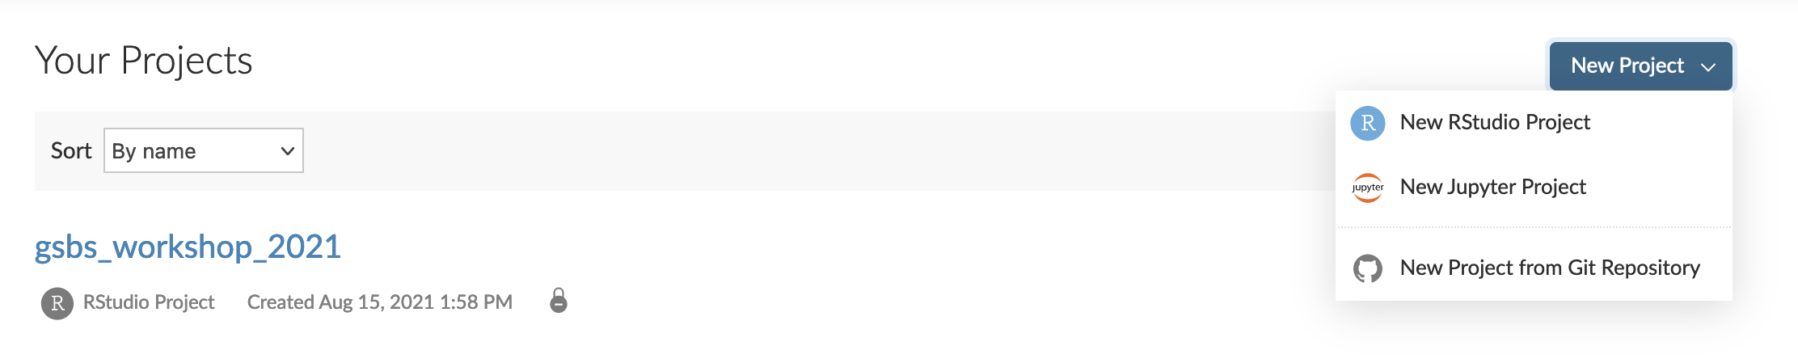
R + RStudio
The activity today will be running on R studio cloud: https://rstudio.cloud/projects
To run the activity, add a new project from Git Repo.
Add the following repo: https://github.com/darlanminussi/gsbs_workshop_2021

Slide 48
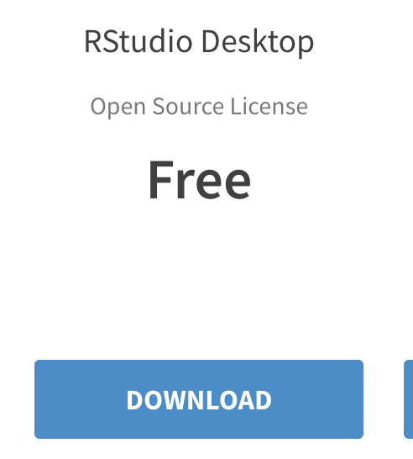
R + Rstudio Locally
If you want to run R locally you can! You just need to install both R and R Studio separately.
To install R: https://cran.microsoft.com/
To install Rstudio: https://www.rstudio.com/products/rstudio/download/
CATS (computational assistance and tutorial session) can help you as well. More info here: https://gsbs.uth.edu/quantitative-sciences/

